Slide 1


Slide 2

BSG 2026
Who wouldn’t want to join us in 2026 and support Redcar Bears Speedway to keep progressing and developing.
All the monies raised go straight back into the club.
Exclusive opportunities including voting for the 2026 Bear and Tiger of the Year, early bird information, U16 mascot of the meeting, reduce travel for away days and much more…
Come and join us in 2026!
Graham, Charlotte, Judith & Brea

Slide 3

BSG Membership 2026 gives you…
Early Bird Notification
The opportunity to buy tickets for Redcar Bears Events - such as Annual Awards Evening and Christmas Party - before they go on general sale.
Rider of the Year Vote
From 2026, BSG Members have the exclusively vote for the Redcar Bear and Middlesbrough Tiger of the Year, with the presentation taking place at the end of season awards evening.
Track Walk
Walk the track, hosted by current and/or previous riders, hear their thoughts, ask them questions and learn what gardening is all about!
Mechanic’s Insight
Meet our mechanics/riders to learn all about how a speedway bike works; know your countershaft from your clutch basket, your primary chain from your sprocket!
Birthday Card
Receive your own birthday card, signed by all the riders.
Team Photo
A unique chance to have your photo taken with the 2026 Redcar Bears Team
BSG Travel Opportunities
Advanced ticket purchase opportunities and reduced travel costs for all BSG Away Day Trips
Weekly Drinks Draw
Your weekly chance to win a free drink - alcoholic/non-alcoholic - from the Bears Bar on meeting nights.

Slide 4
BSG U16’s Membership 2026
U16’s membership add on extras…
Meeting Mascot
Be the meeting mascot, do the coin toss with both captains and have your photo taken, ask your favourite Bear 3 questions, cheer the team out on track from Mascot Corner.
U16’s Fun Running Race
Take part in the BSG U16’s Fun Running Race, held during the interval, your chance to win a prize!
Model Bike to customise
Get your own model bike to paint and customise into your favourite rider’s bike colours.

Slide 5

‘We loved the track walk, Stuart and Jake did ours, they were so informative, it was a great experience…’
‘Having my photo taken with the team was amazing…’
‘A signed birthday card from the team dropped through the letter box, wow!...’
‘The away days were incredible; the atmosphere and friendship were brilliant…’
‘To have a unique say in the ‘Bear of the Year’ was so special…’
‘Having unique experiences whilst supporting the club is a brilliant opportunity you only get with the BSG…’

Slide 6




Slide 7



BSG Quiz Night – Saturday 7th March 6.30pm - £5 including blind card entry

Slide 8
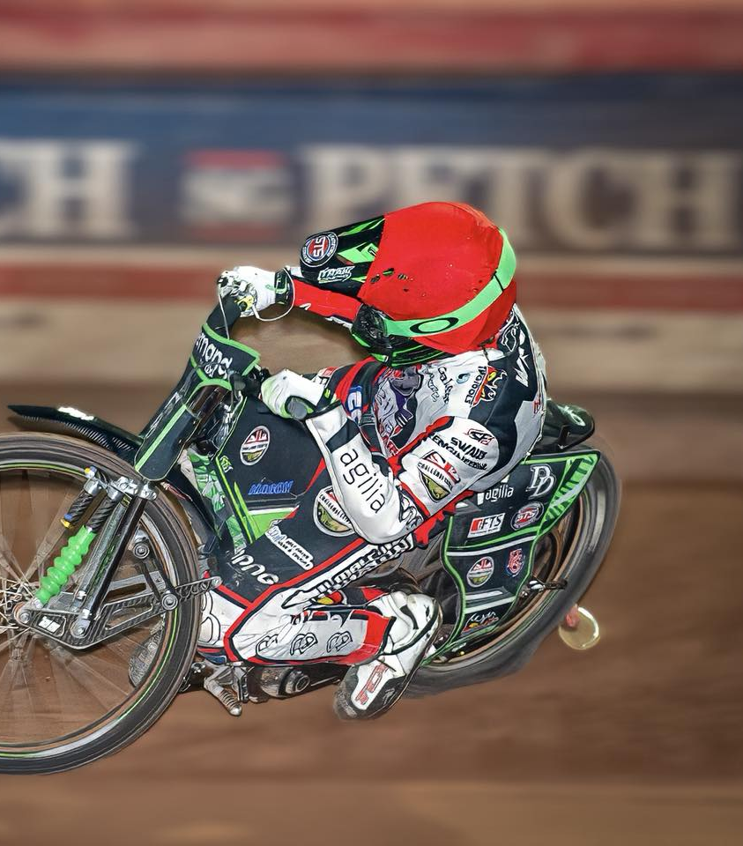
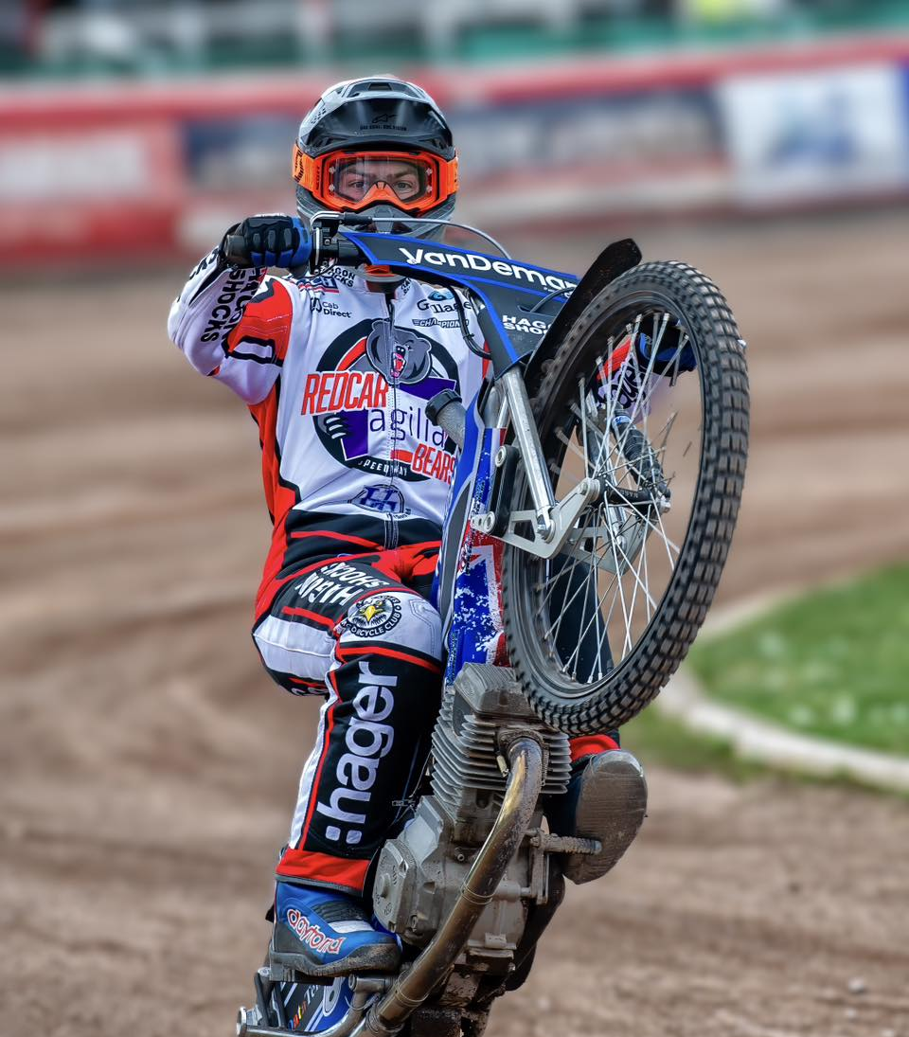
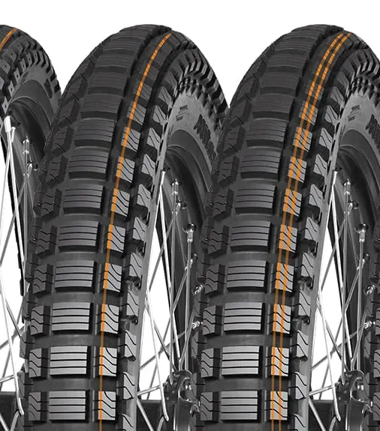


New ‘old’ initiative for 2026
The Tyre Fund
…funding the grip, supporting the slick; the Bears Tyre Fund 2026

Slide 9



